Slide 1
Proof of Collaborative Learning: A Multi-winner federated learning consensus algorithm
Amirreza Sokhankhosh, TCDT
University of Manitoba
June 2024

Slide 2

Bitcoin mining = Poland?
Bitcoin is the world’s first cryptocurrency that lets people send money directly to each other without the supervision of a trusted third party, such as a central bank. Bitcoin is the first technology to introduce blockchains.
A major downside of Bitcoin its substantial energy consumption. Currently, the electrical energy consumption of Bitcoin is comparable to the whole country of Poland! [1]

Slide 3

Proof of work
The massive energy consumption of Bitcoin is the result of its consensus mechanism, Proof of Work.
In this algorithm, miners try to solve a complex, yet impractical, puzzle to add new transactions to the blockchain. This process ensures that all transactions are verified and prevents fraud.
Miners find the solution, called nuance value, through complete trial and error. Hence, they require massive computation power and unimaginable energy to miner transactions.

Slide 4

How about reusing the computation for something more meaningful?
A popular solution to the energy consumption problem of Bitcoin is to reuse the otherwise wasted computation power of miners for a more meaningful task.

Slide 5
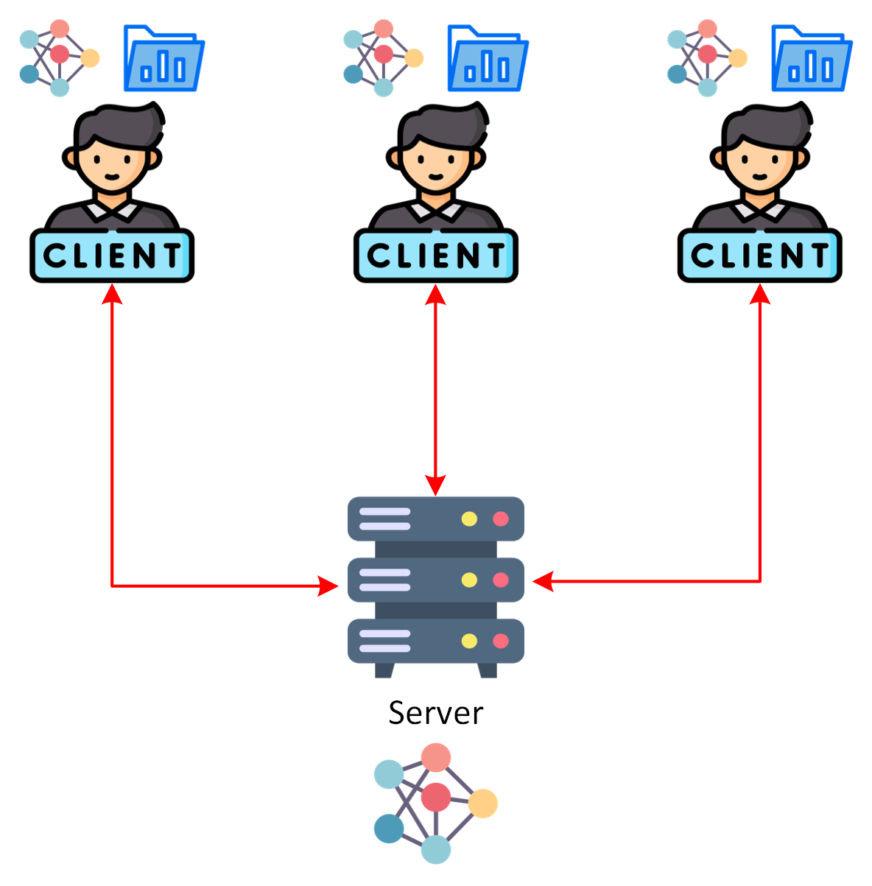
Federated learning
Federated learning is a method for training AI models across multiple devices. Instead of sharing raw data, each device trains the model locally and only shares the updates. This keeps data private while still improving the AI.

Slide 6

Proof of federated learning [2]
In proof of federated learning, the computation power of miners is dedicated to training models using federated learning. In this consensus mechanism, the miners form mining pools where federated learning takes place. In addition, in this framework, entities named requesters submit ML tasks they want developed. Each mining pool will then develop and train a different miner for this task.

Slide 7
Downsides of proof of federated learning
FL is only achieved in pools with a limited number of miners, thereby undermining the efficiency of models trained.
The requester has no control over the model design.
The system isn't fair because the winning global model isn't shared with other groups. This gives an unfair edge to groups that win early on. Miners who join later are at a big disadvantage because of this.

Slide 8
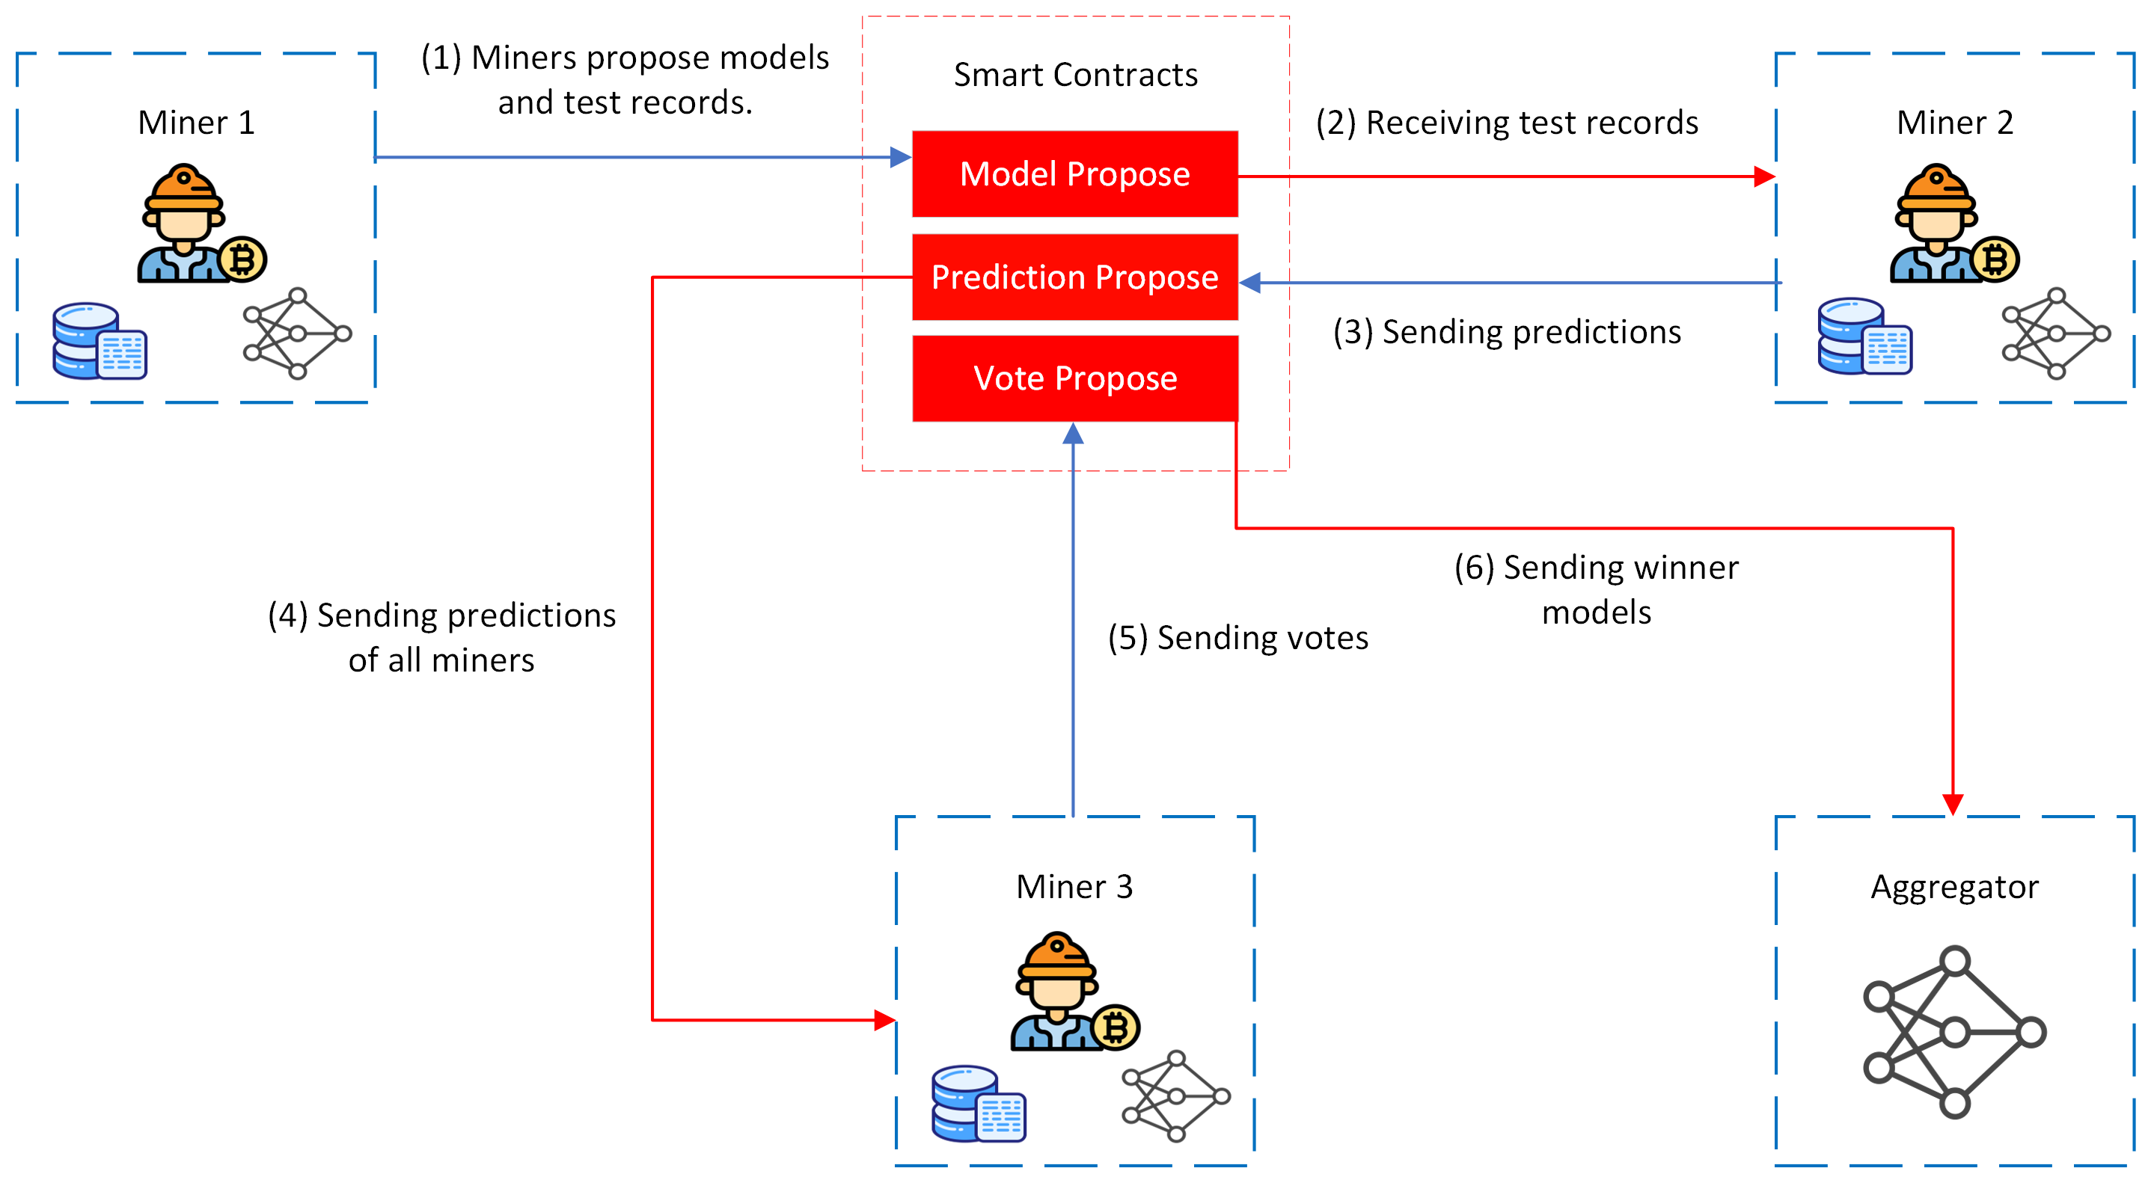
Our proposal
1. Model Proposal
2. Prediction Proposal
3. Vote Proposal
4. Winner Selection
5. Block Creation
6. Reward Mechanism

Slide 9

Attacks and security
We argue that the miners might use their data to utilize a different supervised or unsupervised algorithm and provide predictions.
In our paper, we fully prove that this is not the case because the time it takes to perform such algorithms and their efficiency is not better than DNNs.

Slide 10
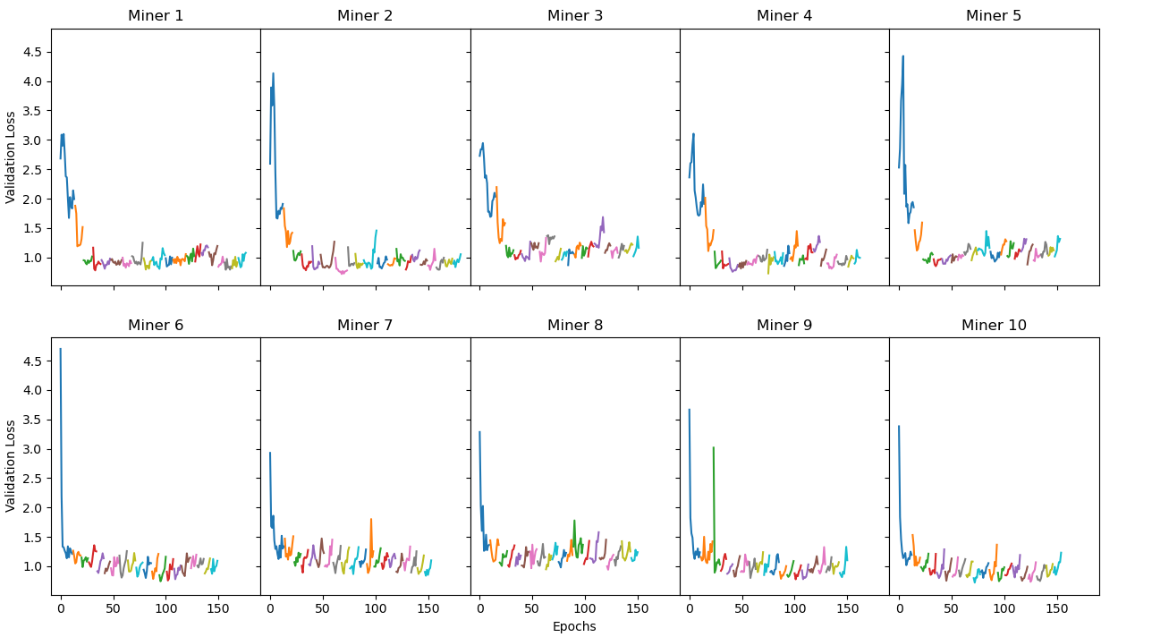
Results

Slide 11
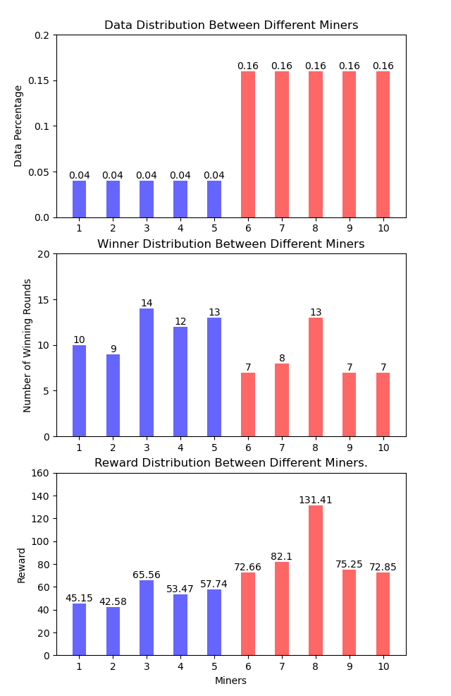
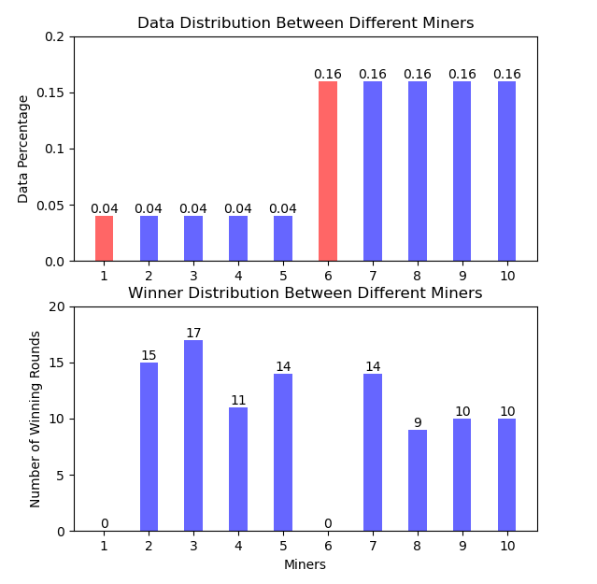
Results (Cont.)

Slide 12
References
[1] (2024) digiconomist. [Online]. Available: https://digiconomist.net/bitcoin-energy-consumption
[2] X. Qu, S. Wang, Q. Hu, and X. Cheng, “Proof of federated learning: A novel energy-recycling consensus algorithm,” IEEE Transactions on Parallel and Distributed Systems, vol. 32, no. 8, pp. 2074–2085, 2021.

Slide 13

Thank you so much for listening! Any Questions?
TCDT Lab : https://tcdt.ca/
University of Manitoba, Canada.

